Slide 1
Google

Slide 2
Business profile
Google began in 1996 by student at Stanford University.
They created marketing mix product:
-Google maps
-Google Chrome
-Google News
-Google Earth
-Google Finance
The vision of google is:
To make search engines so powerful that they would understand “everything in the world”
More info on how to use this template at www.slidescarnival.com/help-use-presentation-template
This template is free to use under Creative Commons Attribution license. You can keep the Credits slide or mention SlidesCarnival and other resources used in a slide footer.

Slide 3
When did they begin their socially responsible program?

Slide 4
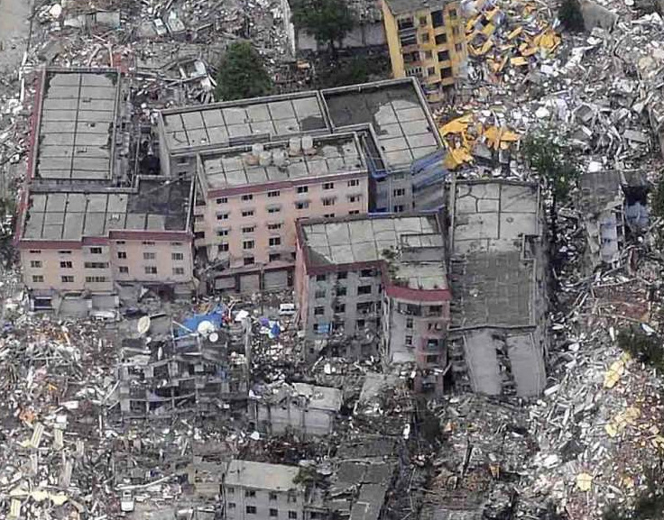
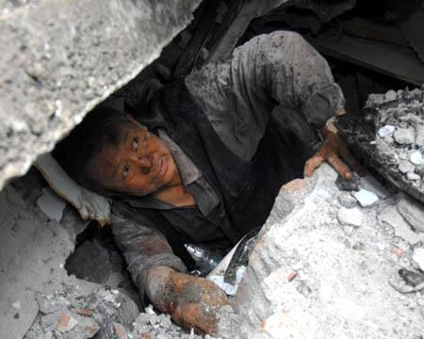
Their program was begun in 2008.
After May, 12th
Where there was an earthquake struck Sichuan province in, Western China.

Slide 5
Focused on
People in Sichuan province
Rescue workers
Elementary and high school student

Slide 6
They provided free online advertising about raising money for earthquake relief organisation
They developing communication platform which helped in searching for supported resources, lost families, and charitable donations.
Google map provided China’s State Bureau with surveying and mapping with satellite images of quake-affected regions

Slide 7
What is the impact of their socially responsible work on their business?

Slide 8
From what they did, what benefit will company gain is
A good image for their company
More user in some of their function
- Google map
- Google earth
- Google news

Slide 9
How can they build or expand their work

Slide 10
They can continue work in other country that have disaster
They can support uneducate people for example give scholarship or help they find the work.
They can use google map find lost people.
They can donate food and drink to people that lack of foods

Slide 11
What other companies, do you think, would benefit from adapting a similar program

Slide 12
Facebook or instagram might be other company that also can benefit from this program too. Both of them have power in our society. By posting an advertisement to encourage people for donating or volunteering.

Slide 13
From your group’s, why is being society responsible good for business

Slide 14
It make consumer felt that this company are responsible for society and most of consumer want to help society. So, this company make consumer believed in them.

Slide 15
Thanks!
Any questions?

Slide 16
TORFON
KEEN
PRAI
LING
BENZ

